Slide 1
Mechanics and machines, lab 1
Intro to subject
History of CAD
Solid modeling

Slide 2
Рефлексия
Сделать упор на консультации: заставлять студентов приходить каждую неделю показывать результат обязательно (часть оценки)
Жесткие дедлайны по проекту. Не продлевать дедлайны. Late submission жестко.
Лабы делать динамическими: есть набор тем и по ним идти, остальное - офис аурс
В папке “Проект Информация” лежит Teli et al. - 2019 - Design and Fabrication of Multi Legged Robot-annotated. Они должны репорт оформлять в оверлифе каждый блок, а потом в конце можно будет его опубликовать.
Лабы переименовать в таком формате MAM2022_lab_x_ХХХy , где х - номер лабы, А ХХХ описание краткое лабы (KIN - кинематика, ASM - сборка) итп, y - номер лабы по этой теме
https://www.youtube.com/watch?v=5XANvWyDaio&list=PLN1iOWWHLJz3ndzRIvpbby75G2_2pYYrL&index=25 курс Стенфорда на схожую тематику

Slide 3
Class activities
Triple repetition: lab, HW, project

Slide 4
Hometasks
In total — 8*2 = 16 (1 week - 1 HW):
HW CAD 1 - CAD, simple detail
HW CAD 2 - CAD, complex detail
HW ASM 1 - CAD, simple assembly + render
HW ASM 2 - CAD, complex assembly using naming convention
HW DYN 1 - CAE, solve Inverse Dynamics Problem
HW BAL 1 - CAD+CAE, balancing mechanism
HW SSA 1 - CAE, Static Structural Analysis
HW TSA 1 - CAE, Transient Structural Analysis

Slide 5
Lab goals
To obtain the needed tools for solving the design part of the course project

Slide 6
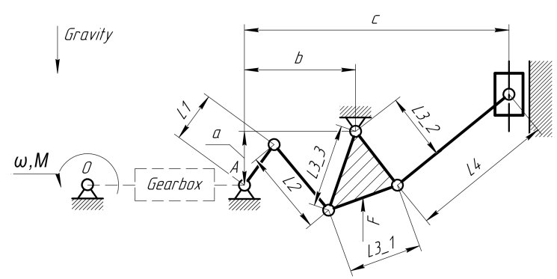
Almost final exam task
Make CAD model
Solve Inverse Dynamics problem
Balancing the mechanism
Propose a gearbox
Check the durability of the mechanism

Slide 7
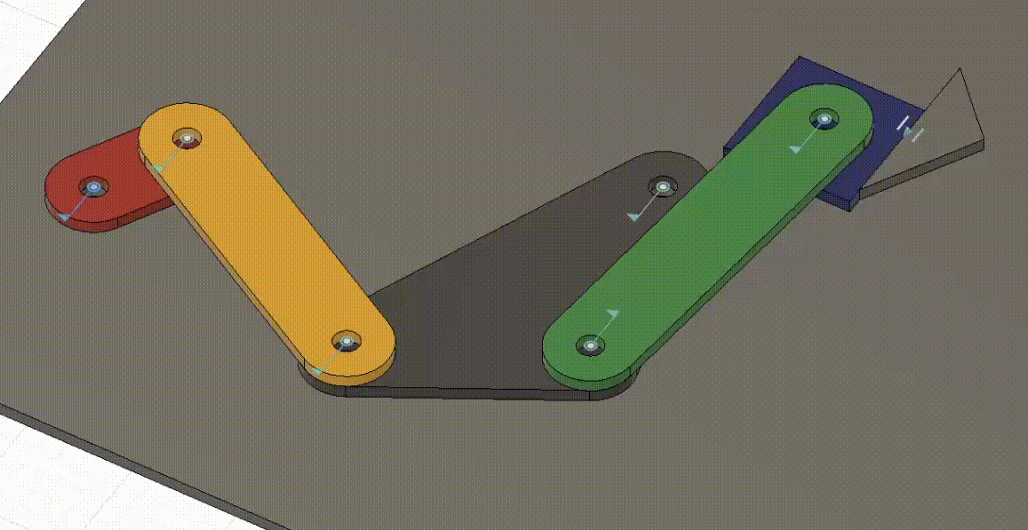
Fusion 360: kinematics

Slide 8
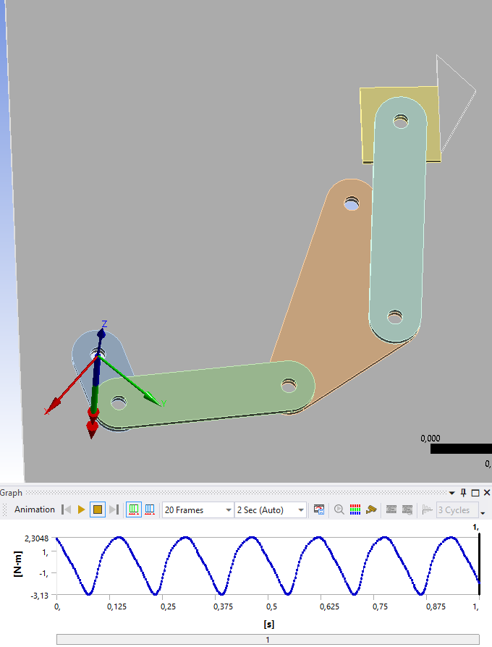
ANSYS: inverse dynamics problem

Slide 9
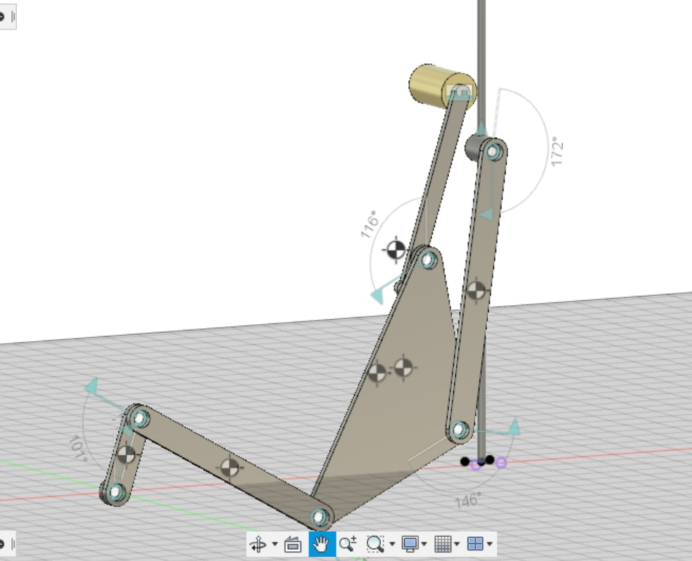
Balancing
Gold bullion

Slide 10
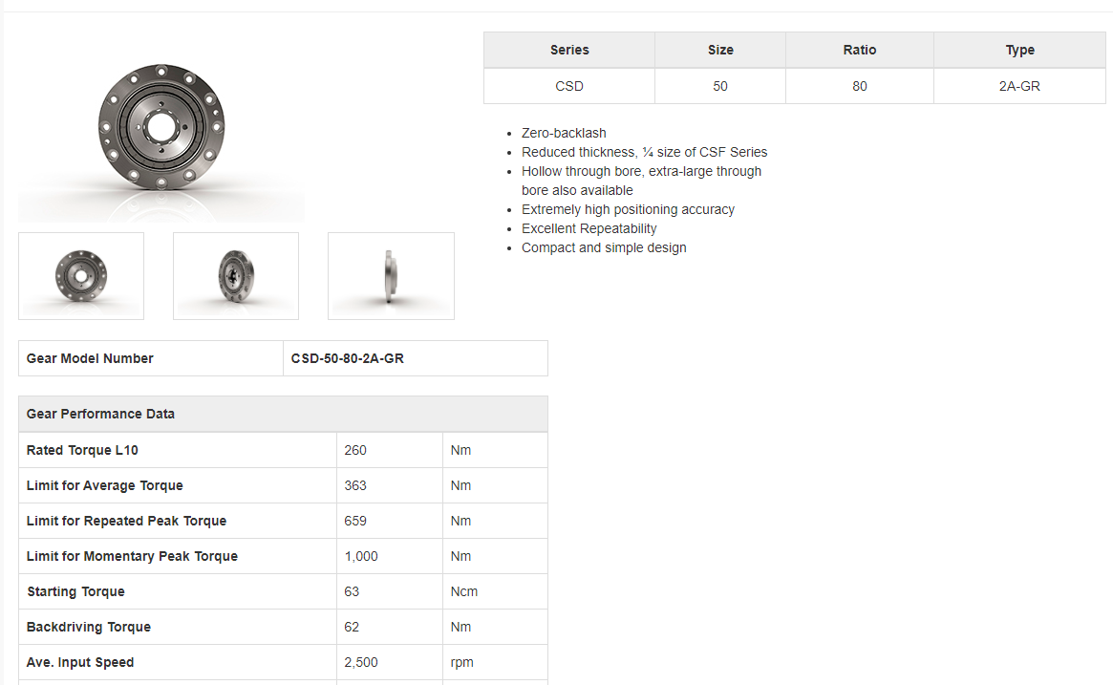
Gearbox

Slide 11
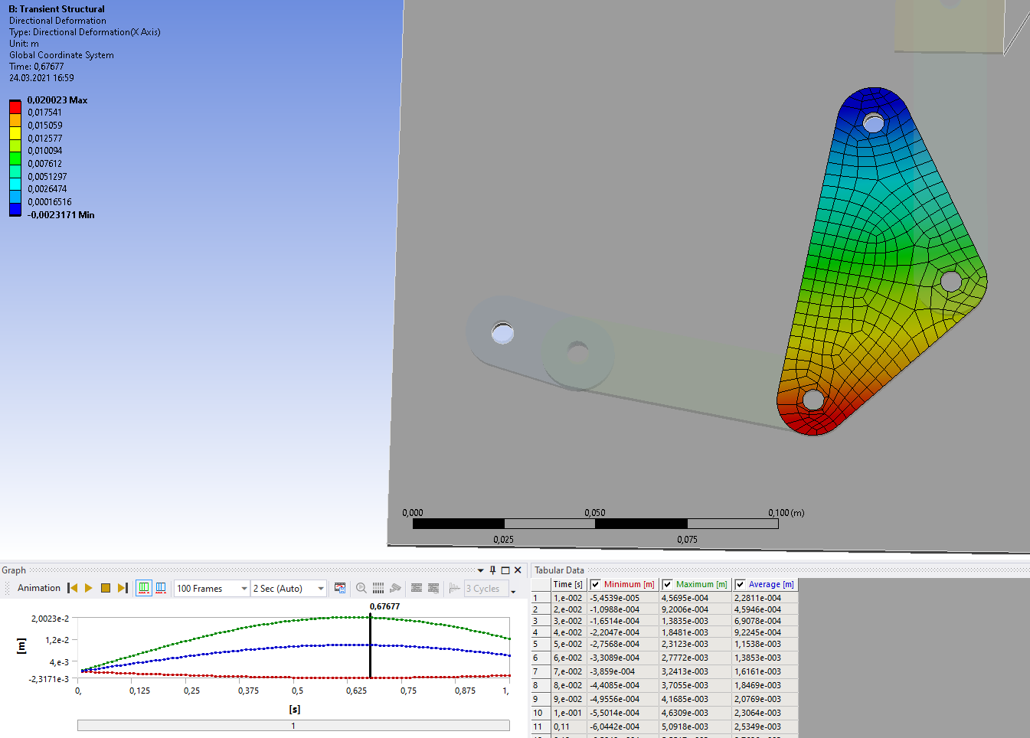
Transient Structural

Slide 12
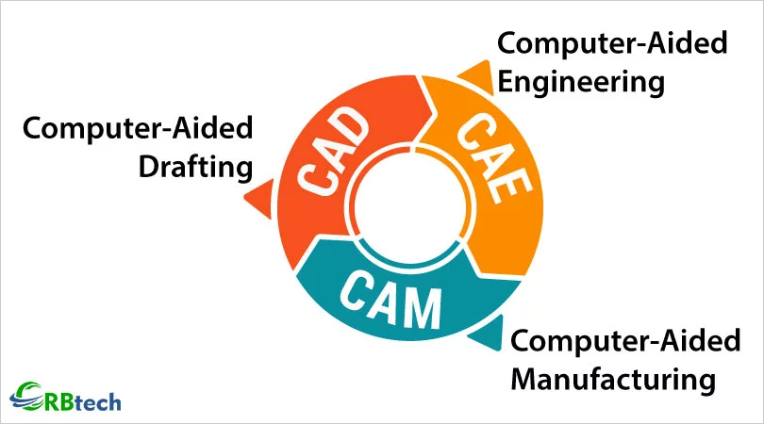
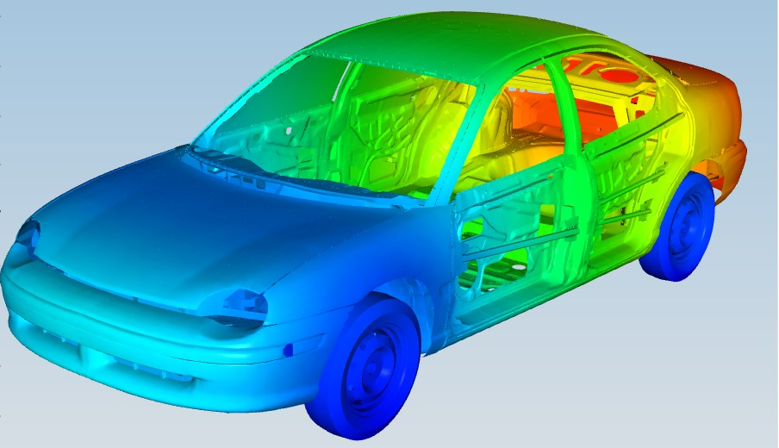
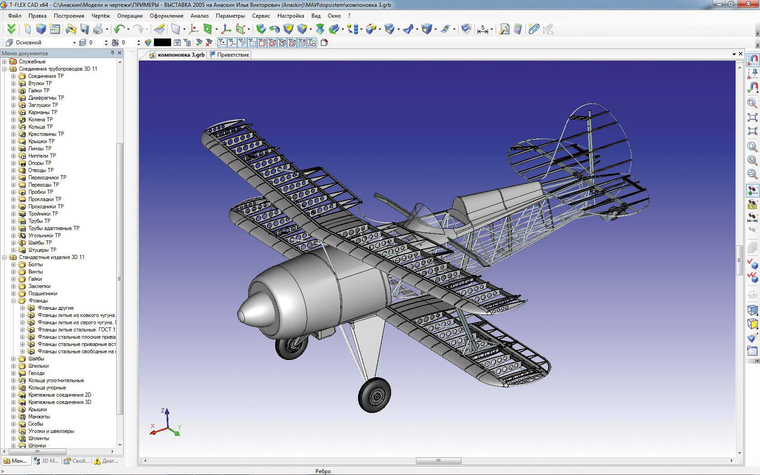
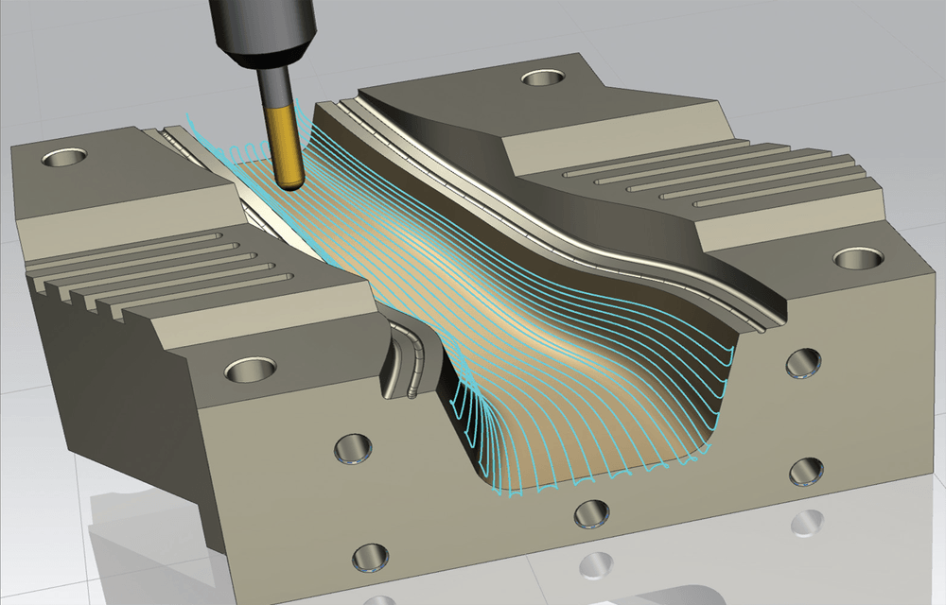
Computer Aided Design (1)

Slide 13
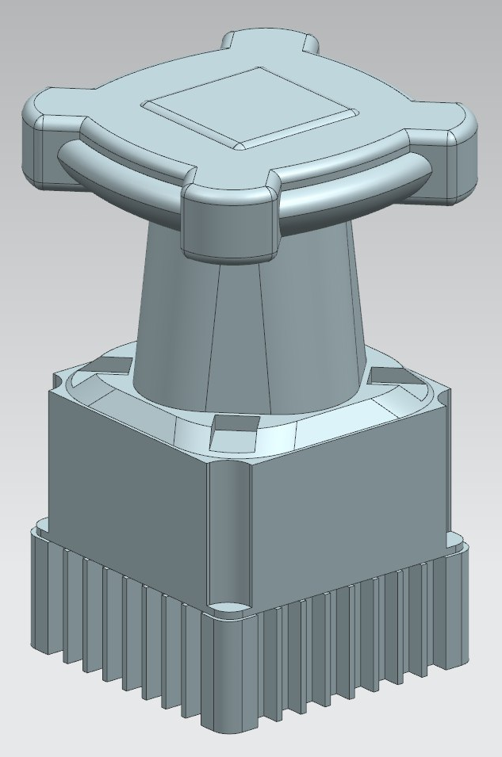
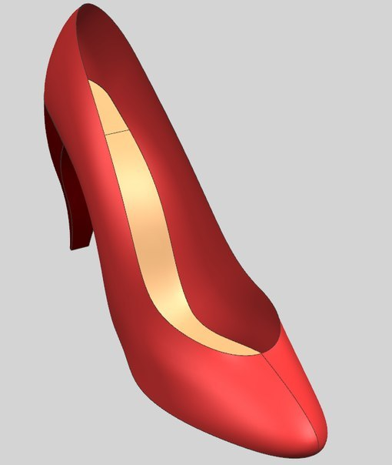
Computer Aided Design (2)
Solid Modeling
Surface Modeling

Slide 14
History of CAD (1)
60th — Theoretical studies of the possibility of solving design problems on the computer were carried out.
70th — Methods, algorithms and programs for solving individual tasks for different design stages were developed.
80th — CAD is being developed and improved. 3D modeling became more popular.
90th — Developers had finished formation of base concepts of CAD and unified data transfer between systems.

Slide 15
CAD benefits
Cheaper
Safer
Faster

Slide 16





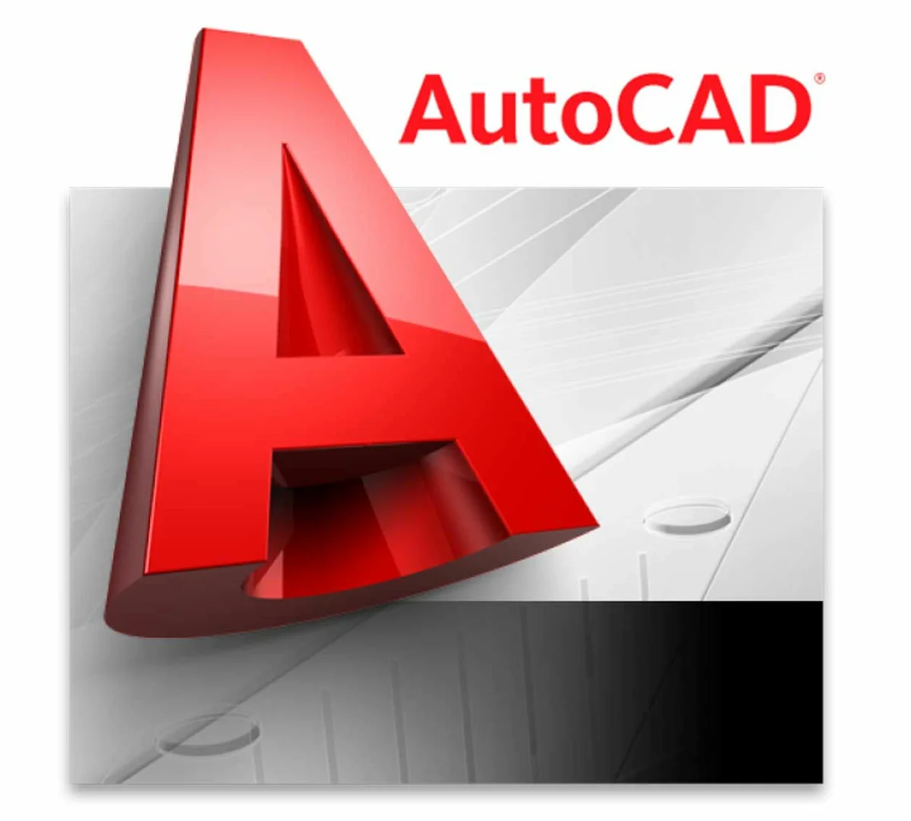
Popular CAD systems in Russia (1)
CAD
CAD/CAM/CAE/PDM
CAD
CAD/CAM/CAE/PDM
CAD
Inventor
SolidWorks
Компас 3D
Siemens NX
AutoCAD

Slide 17
Siemens NX
Prof
All in one system (CAD,CAM,CAE,PDM)
Free for students
Can create a real aircraft
Cons
Complex system
Not popular in small companies
CAD/CAM/CAE/PDM
Siemens NX

Slide 18
Common usage
If you need a good drawings. Make CAD anywhere, afterwards import to Kompas-3D
If you need Standard Component Library (SCL), use either Kompas, or Solid Edge, or https://www.mcmaster.com/ . Insert needed stuff in NX

Slide 19
Creating a solid body
Most of the bodies can be created using only 4 operations:
Sketch
Extrude
Revolute
Combine

Slide 20
NX workspace, checklist
Browser
Design History
Toolbar
Data Panel
View Cube
Help

Slide 21
Sketches, checklist
Choose Plane
Construction
Toolbar
Constraints
Change Parameters

Slide 22
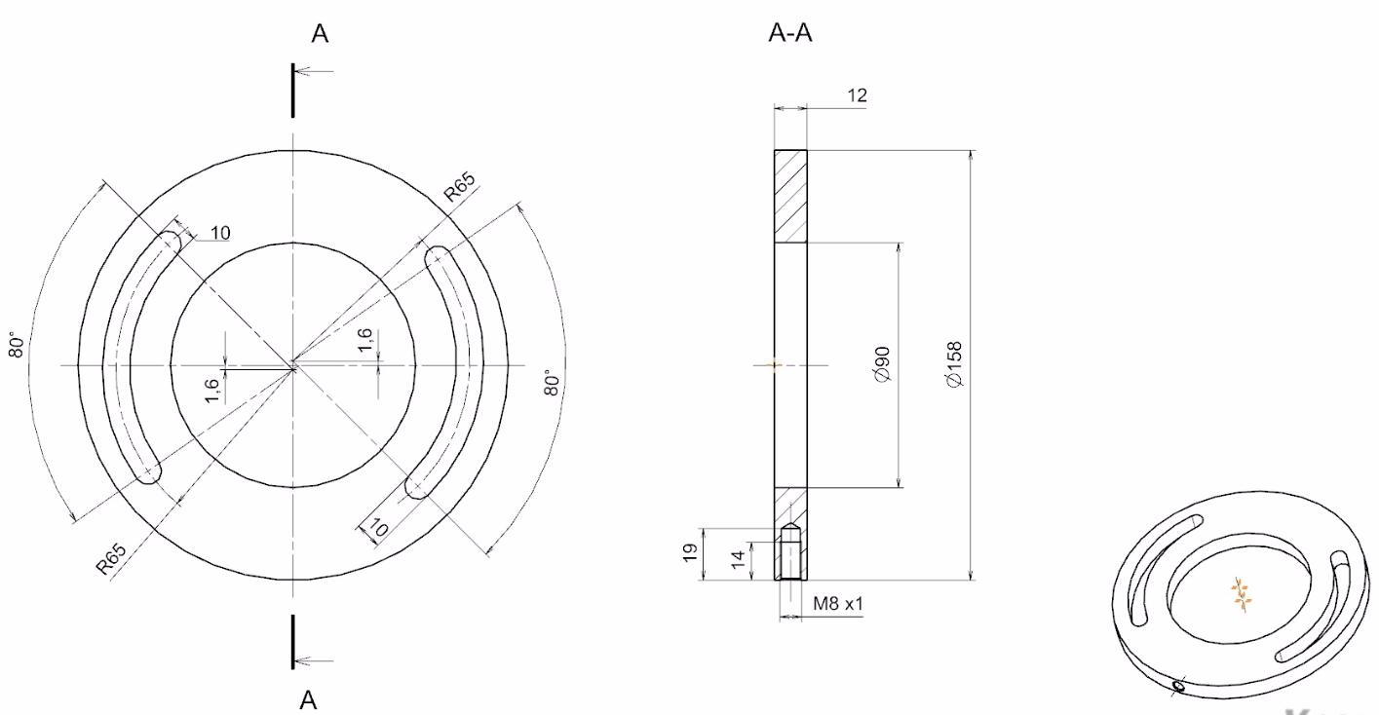

Slide 23
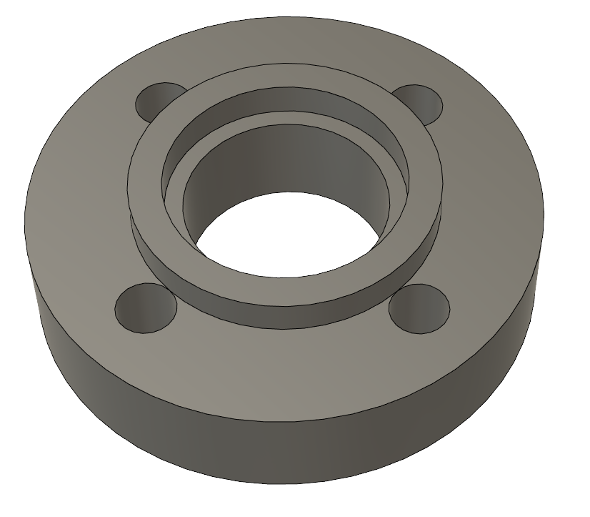
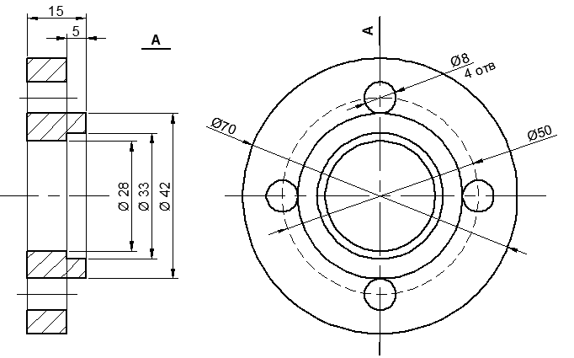
Task 1: make CAD model of detail below

Slide 24
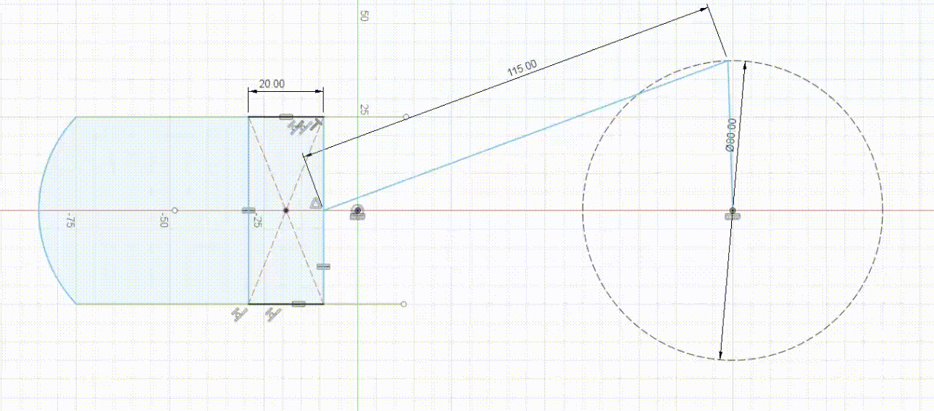
Task 2: make an animated sketch

Slide 25
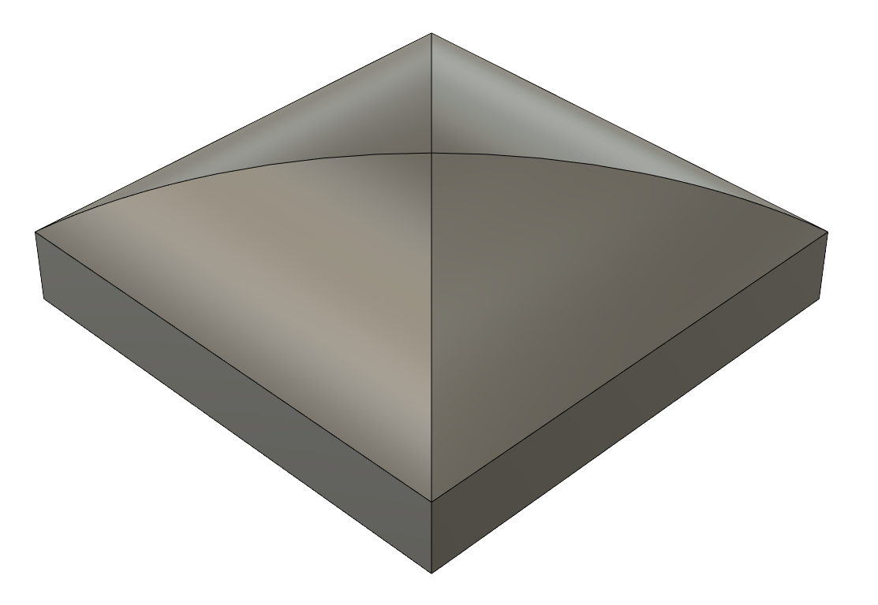
Task 3: make CAD model of detail below
Hint: It can be solved making 2 equal sketches perpendicular to each other, extruding them and using “combine” command

Slide 26
References
NX interface
https://urokinx.ru/

Slide 27
Deserve “A” grade!
– Oleg Bulichev

